Slide 1

A community-driven intelligent language service dapp

Slide 2
Catalog
01
02
03
Introduction
Team
Product
05
04
Roadmap
Market value

Slide 3




What does Amphi do?
Lower cost for buyers. when buyer publish a bounty on amphi, they will recognize they do not need to negotiate with the sales and bargain price, get translation service is easy like order a takeout.
High quality service. amphi have tripartite supervision mechanism and DAO to supervise the high quality of translation.
More efficient transaction. the translator and validator will feel they can get payment much faster than previous, they get paid 1 month a time once they finished, and now just 1 minute.
Increase translators' revenure, the translator and validator will find they can work more than usual and more efficient and the AI tools are free.
01

Slide 4
Team member
Name | Position | Advantage
Kim | Product | Kim learned about blockchain during her master's degree at Chulalongkorn University and has 10 years of experience in the language service industry. She is good at starting from scratch. She worked in a top Fortune 500 company and kim once built a translation platform to handle tens of millions of translations, and formed a multilingual online team of 83 people. She won the "Best Popunlarity Award" in the Vland Metaverse Global Commercialization Competition.
Why | AI engineer | Why graduated from Chulalongkorn University, Why has published papers in IEEE and has extensive experience in the field of artificial intelligence he won the “Best Popularity Award” in the vland Metaverse Global Commercialization Competition.
Jacky | Front-end engineer | Jacky has 13 years experience in a Fortune 500 company and he is good at task management system development, additionally, he developed a dao project before.
Rui | Scene designer | Rui graduate from RMIT University Melbourne City Campus, good at 3D modeling design and has rich experience in metaverse design
Amo | UI designer | Amo study design majors both undergraduate and master degree, she has a strong understanding ability and a sense of responsibility, and Amo is a good ui designer.
Benio | NFT designer | Benio started to draw pictures since a child and he always get No.1 in art class, he has a variety of design skills and designed a virtual idol.
Jack | NFT contract | Jack developed multiple web3 projects and one of them was successfully acquired.
下次一定早睡 | Smart contract engineer | 下次一定早睡 is an excellent senior who has participated in multiple contract code competitions and has more experience than some solidity developers.
黑鹳 | Back-end | He has rich experience in web3 developement, familiar with rust and java has developed chains, wallets and nft platforms.
尹乐 | Testing | He worked in a wallet company and joined the blockchain for 4 years. He has rich trading experience.
Scott | Front-end engineer | Scott has 10-year work experience in front-end and join in crypto 5 years ago, with multiple web3 project experience, has developed uniswap and decentralized exchanges.
Sometimes | Front-end engineer | Sometimes has 6 years experience in front-end develop, he is good at react .
02

Slide 5
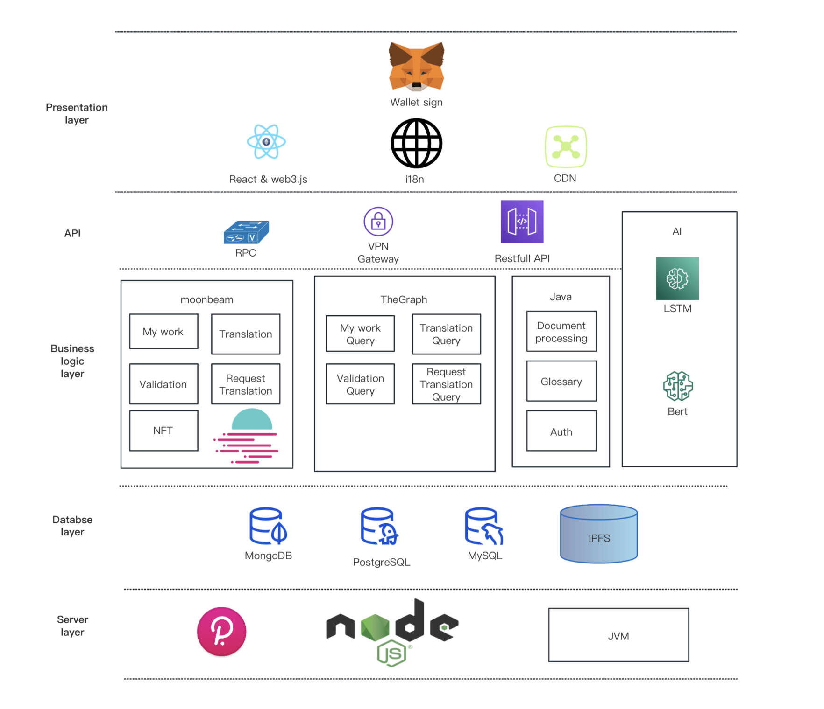
Technology Architecture
except business is onchain, we also provide opensource translation intelligent tools.
03

Slide 6
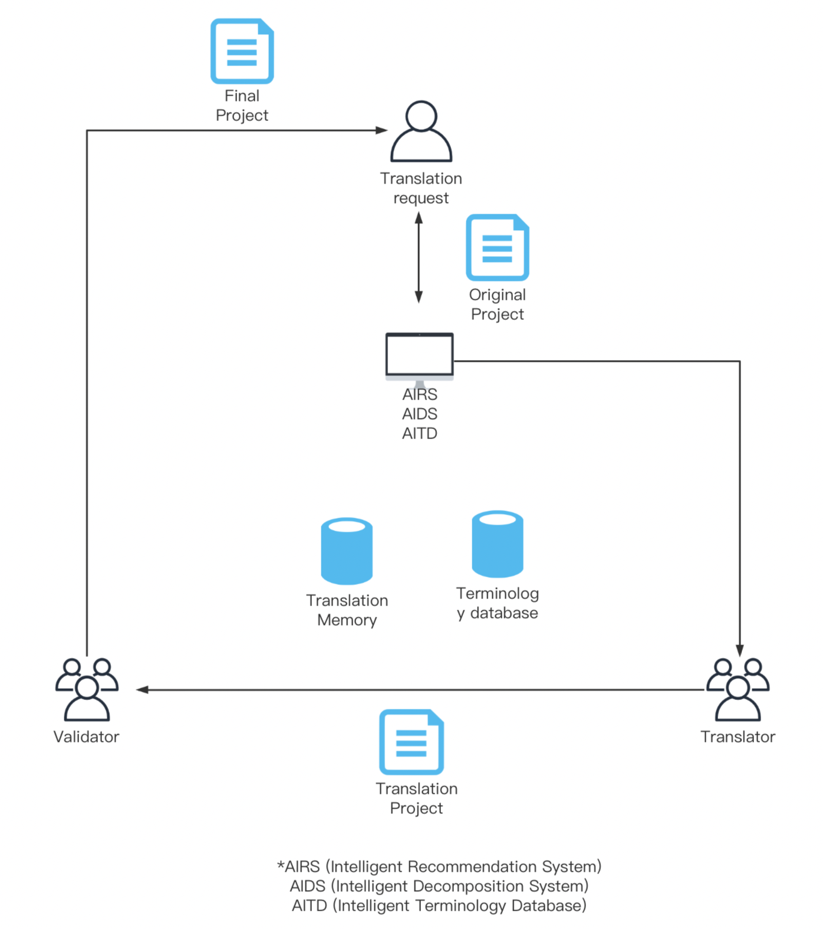
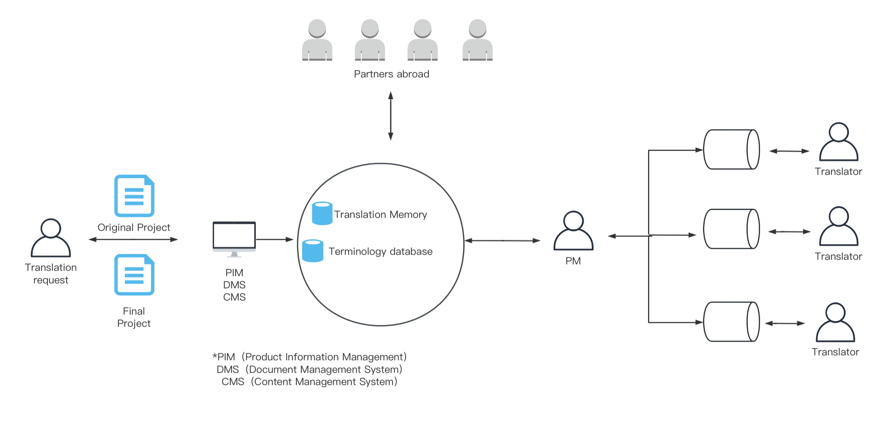
Web2 language service vs amphi decentralized language service
amphi expand the workload limitation line. the task will not decide by only the company or the project manager, translator and validator can cooperate well and control the quality well here. normally, translator and validator stand the same side to serve buyer in web2 translation company, amphi's smart contract separate their responsibility that validator should control the quality of translator for himself/herself, because the under standard quality will affect only validator's revenue not translator's. So the quality will be control between these two party. Additionally, amphi DAO member can vote for the better quality if there is proposal related.
The centralized PM is the limitation workload.
03

Slide 7
Roadmap
Complete Product
Efficiency
complete business code
complete whitepaper
complete tech papers
complete glossary UI design
complete first vision of community rules
complete AI glossary database vision1
complete AI translation memory vision1
complete vote function
start decompose task system
DAO start to set rules
2022.12
2023.7
2023.12
Start MVP
2023.3
Communication
2023.10
Next
Amphi DAO start
Amphi UI Design
Amphi NFT Development
Amphi dapp MVP development
complete glossary database vision1
Iterate user experience
Iterate community rules
mint second batch of NFT
start develop AI translation memory
start vote function
DAO operation by itself
complete decompose task system vision 1
complete API to cooperate with other projects
start provide language service in metaverse
DAO start to build meatverse
04

Slide 8
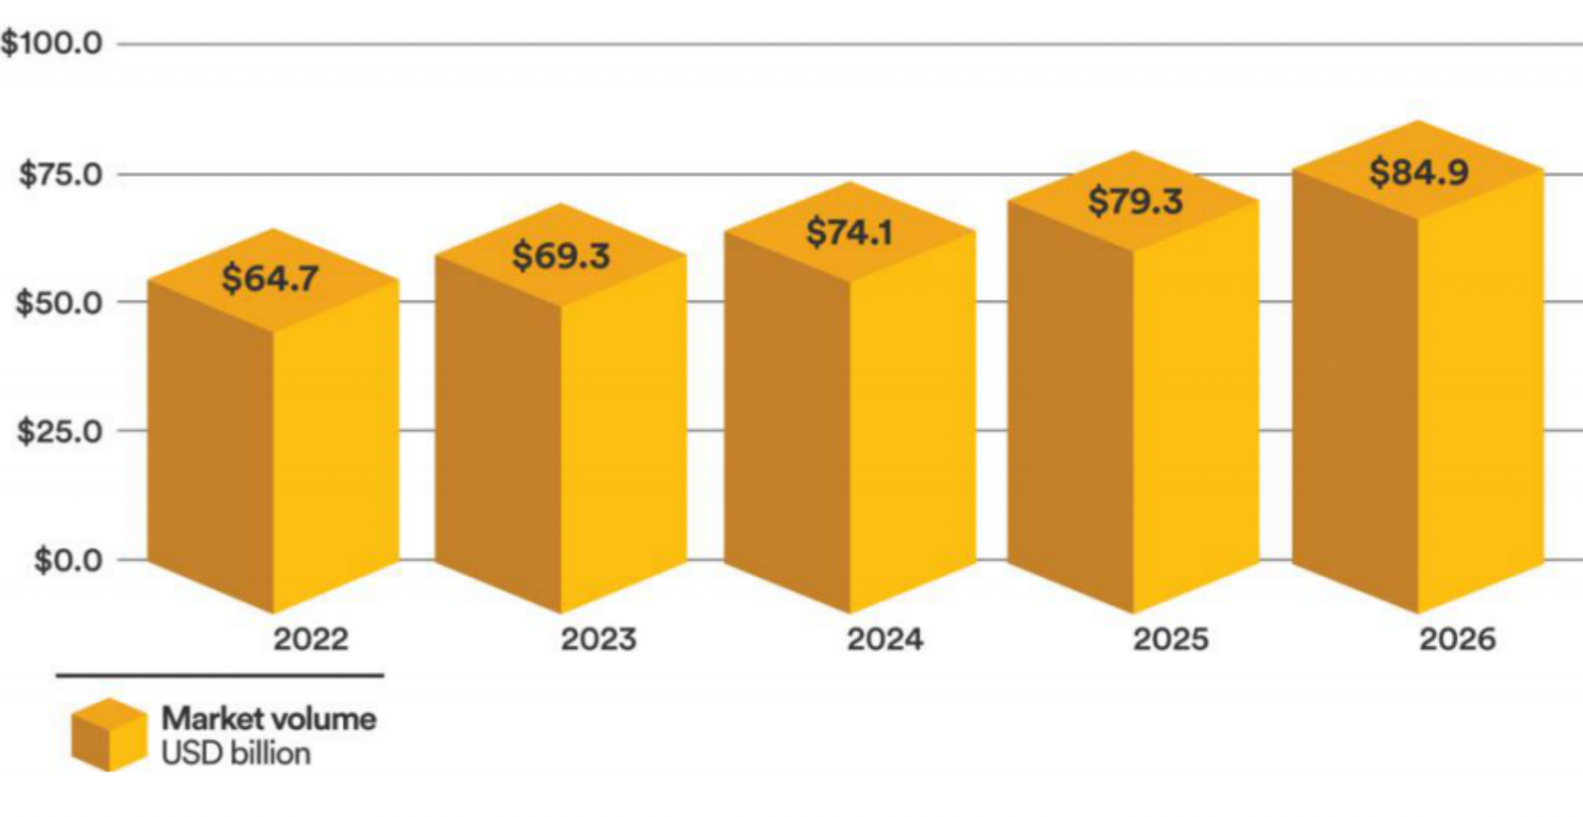
Market forecast for the language service industry
Due to the impact of the epidemic, the market recovery rate is as high as 90%
The market growth rate is optimistic in the next five years
05

Slide 9
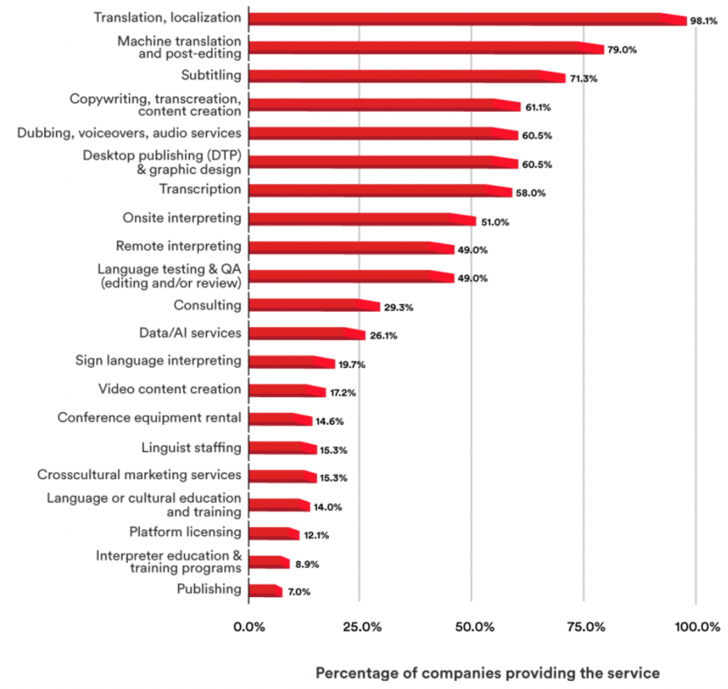
Status of language service industry
＊
＊
1. Significant trend of globalization shows that Localization service has 98.1% market demand.
2. Strong demand of Machine Translation and Post-Editing is 79%.
3. Remote work is the trend that increased demand for interpretation, rising to ninth.
＊
＊
05

Slide 10
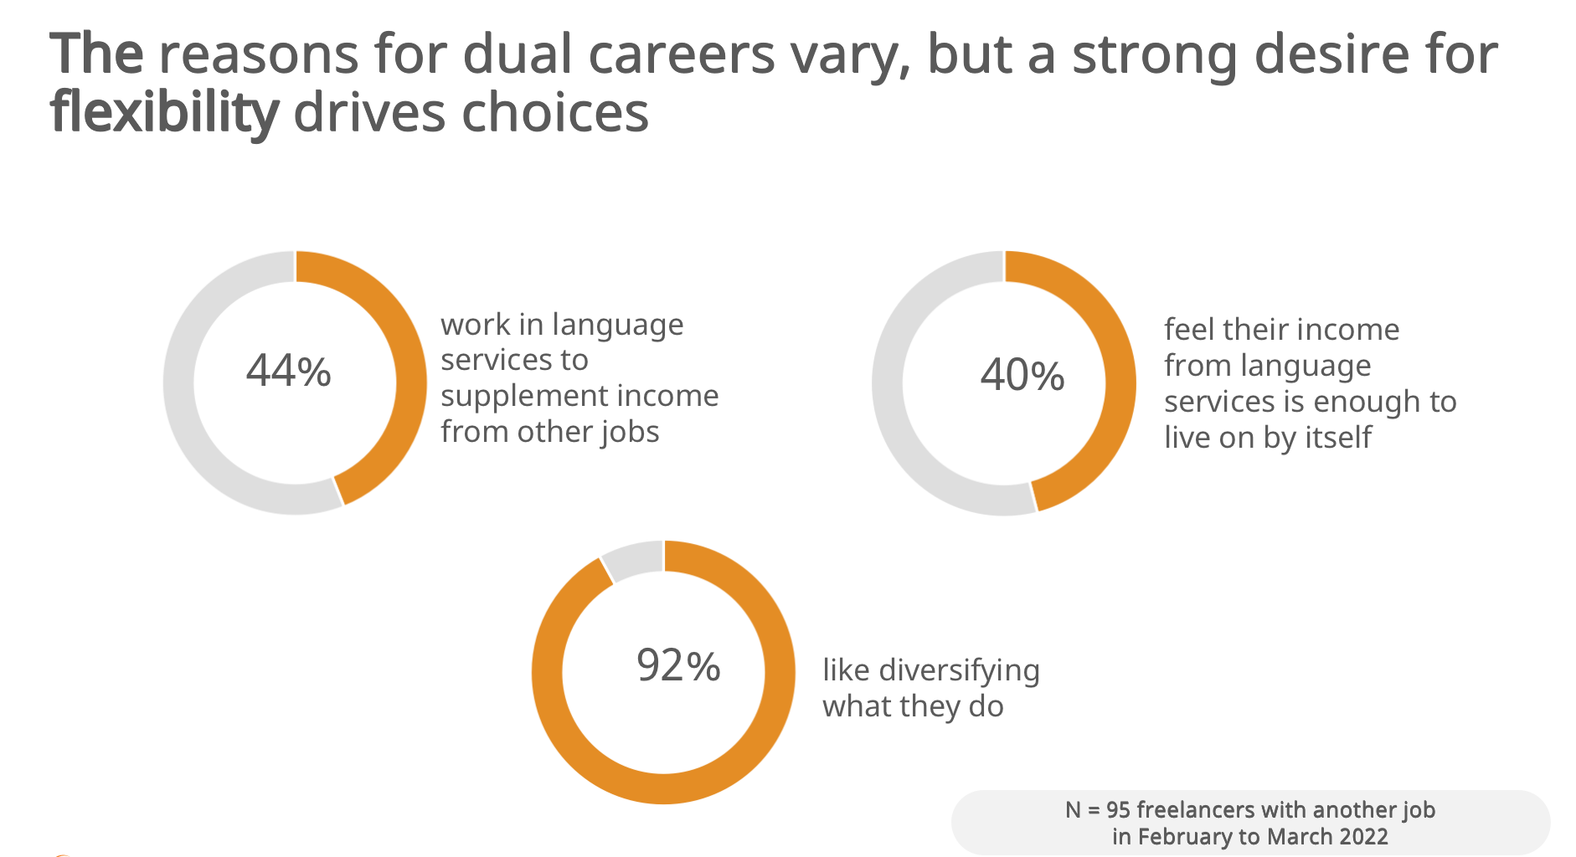
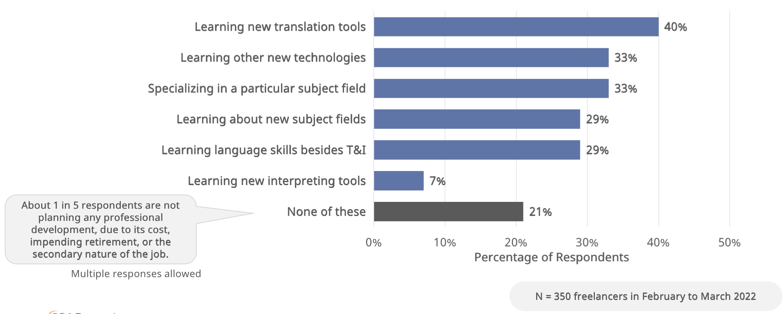
Status of translators
Work from home is the trend and translator used to it. 92% of freelancers like diversifying what they do.
High acceptance of new things: 79% of language practitioners are willing to learn translation-related auxiliary tools.
05

Slide 11
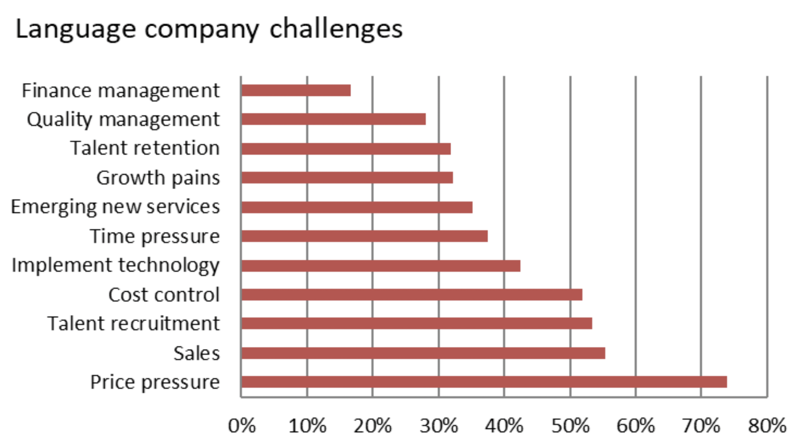
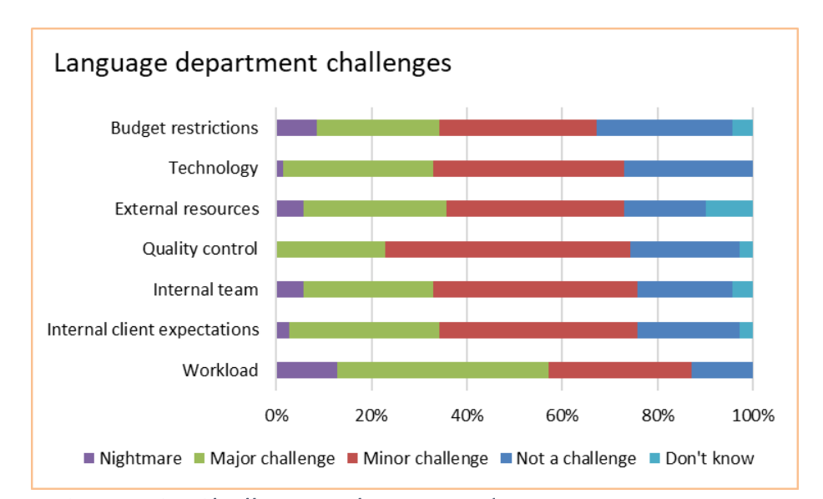
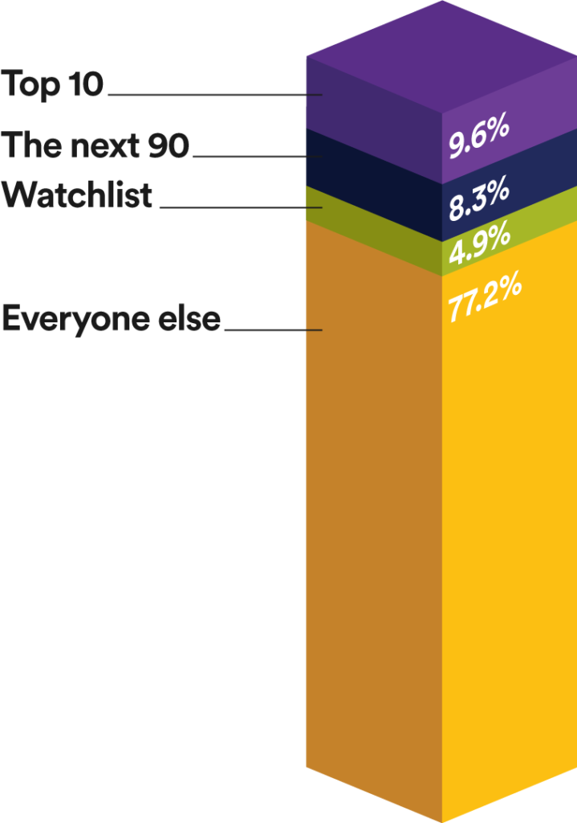
The problems in language service company
Proportion of translation companies in 2021
1.The high cost makes LSC tougher, and most of the cost spend on marketing and sales.
2. Lack of self-operated working methods, relying too much on human coordination, urgent tasks are a big problem for LSCs
3. Lack of transparent market, unqualified small workshops account for 82.1% , they bid at low prices, and price wars disrupt market order and affect industry development.
05

Slide 12
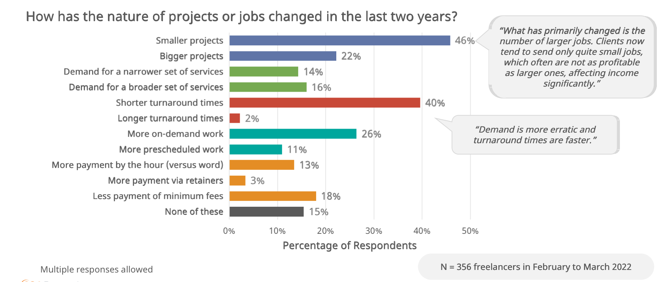
Translator's problem
1. Individuals cannot accept large orders, and there will be middleman fees for joining organizations. 46% said that small orders have a serious impact on income
2. Lack of auxiliary tools, 40% said that the translation task time is short
3. Lack of delivery standards guarantee, 26% said that the real demand for language services exceeds the initial agreement
The Viability of the Freelance Linguist Profession
05

Slide 13
Contact
Twitter: @globalkoon
Website: http://www.amphi.space

